Slide 1
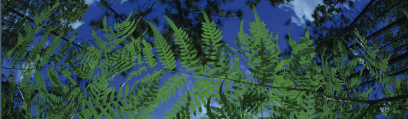



Data Cleaning Overview
University of Florida
Created by Pam Soltis
BiotaPhy

Slide 2
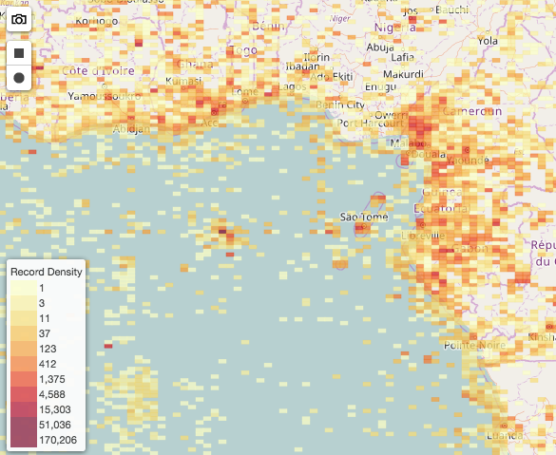
Occurrence Data Cleaning
Resolve taxon names
Decrease number of columns
Remove duplicates
Clean localities
Round up the latitude/longitude
Remove coordinates at 0,0
Remove coordinates in cultivated zones, botanical gardens, etc.
Remove coordinates outside of the desired range
Spatial correction
Produce a csv

Slide 3
Occurrence Data Cleaning
Resolve taxon names
Clean localities
Round up the latitude/longitude
Remove coordinates at 0,0
Remove coordinates in cultivated zones, botanical gardens, etc.
Remove coordinates outside of the desired range
3. Remove duplicates
4. Spatial correction
5. Produce a csv

Slide 4
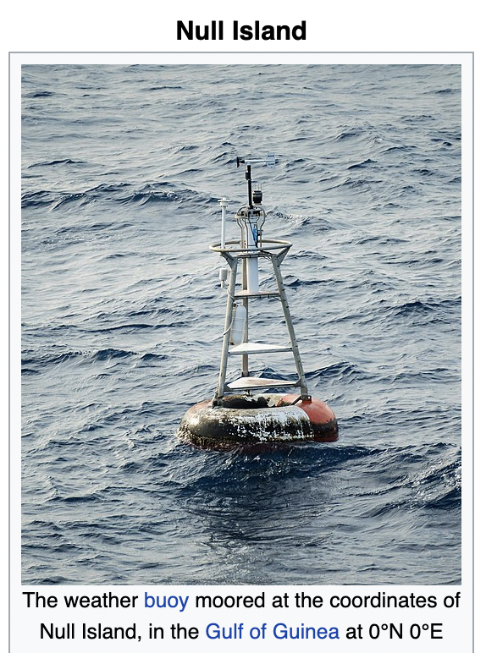
Occurrence Data Cleaning
Resolve taxon names
Decrease number of columns
Remove duplicates
Clean localities
Round up the latitude/longitude
Remove coordinates at 0,0
Remove coordinates in cultivated zones, botanical gardens, etc.
Remove coordinates outside of the desired range
Spatial correction
Produce a csv

Slide 5
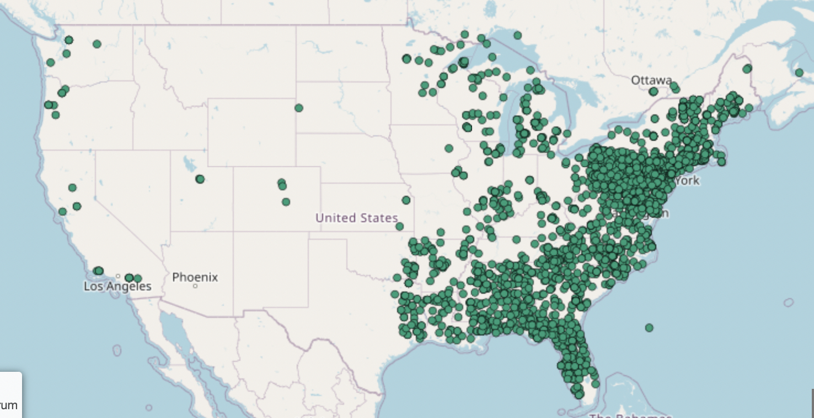
Occurrence Data Cleaning
Resolve taxon names
Decrease number of columns
Remove duplicates
Clean localities
Round up the latitude/longitude
Remove coordinates at 0,0
Remove coordinates in cultivated zones, botanical gardens, etc.
Remove coordinates outside of the desired range
Spatial correction
Produce a csv

Slide 6
Occurrence Data Cleaning
Resolve taxon names
Decrease number of columns
Remove duplicates
Clean localities
Round up the latitude/longitude
Remove coordinates at 0,0
Remove coordinates in cultivated zones, botanical gardens, etc.
Remove coordinates outside of the desired range
Spatial correction
Produce a csv

Slide 7
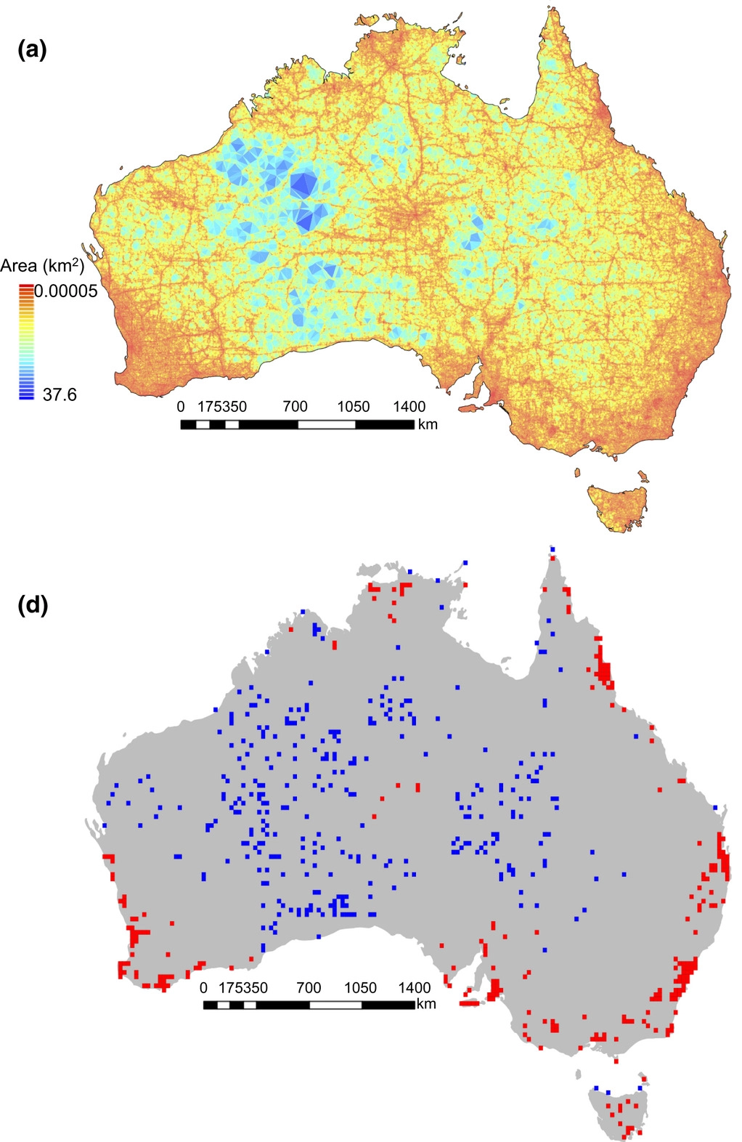
Spatial Correction
Sampling bias for
857,245 records
Sampling bias for
857,245 sites
Collection efforts can lead to clustering of points
Infrastructure (roads, herbaria, etc.)
Taxon bias
Temporal bias
Filtering is a procedure to reduce the clustering of species records
Density of sampling sites
Daru et al. 2018. Widespread sampling biases in herbaria revealed from large-scale digitization. New Phytologist.
# specimens/site

Slide 8
Spatial Correction
Sampling bias for
857,245 records
Sampling bias for
857,245 sites
Collection efforts can lead to clustering of points
Infrastructure (roads, herbaria, etc.)
Taxon bias
Temporal bias
Filtering is a procedure to reduce the clustering of species records
After filtering, there may still be spatial autocorrelation
This can be accounted for by data partitioning
Density of sampling sites
Daru et al. 2018. Widespread sampling biases in herbaria revealed from large-scale digitization. New Phytologist.
# specimens/site

Slide 9
Occurrence Data Cleaning
Resolve taxon names
Decrease number of columns
Remove duplicates
Clean localities
Round up the latitude/longitude
Remove coordinates at 0,0
Remove coordinates in cultivated zones, botanical gardens, etc.
Remove coordinates outside of the desired range
Spatial correction
Produce a csv

Slide 10
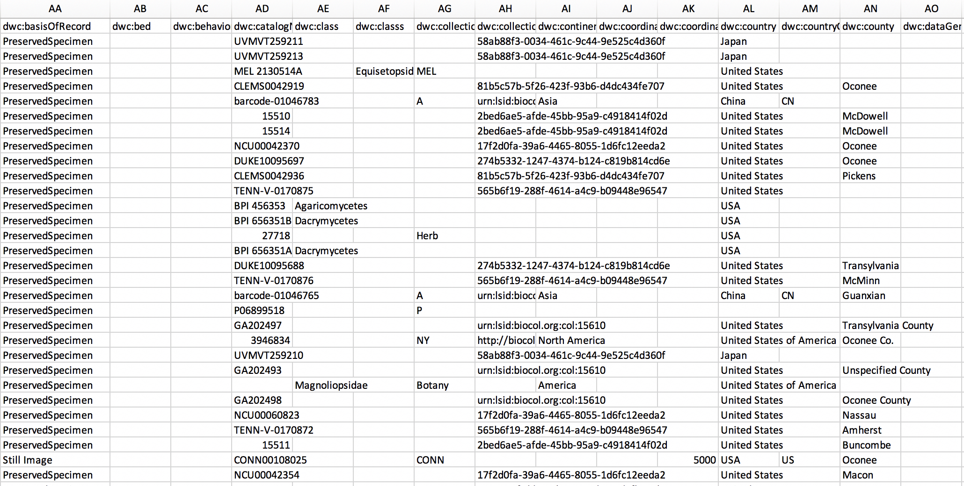
Producing a CSV File

Slide 11

🐊
Geographic And Taxonomic Occurrence R-based Scrubbing
(gatoRs):
An R Package and Reproducible Workflow for Processing Biodiversity Data
Natalie Patten, Shelly Gaynor, Doug Soltis, & Pam Soltis

